Slide 1

Restaurant Data Analysis
Exploring Menu, Orders, and Customer Behavior
Creator: Zohal Zahir

Slide 2
Introduction
Brief overview of the analysis: This project analyzes restaurant menu data, order details, and customer behaviors using SQL queries.
Sections covered: Menu Analysis, Order Analysis, Customer Behavior Analysis

Slide 3
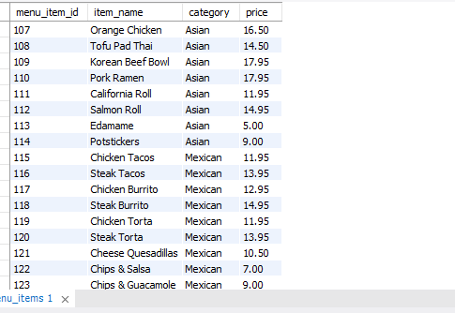
1. Viewing the Menu Items
SQL Query: SELECT * FROM menu_items;
Menu Analysis

Slide 4
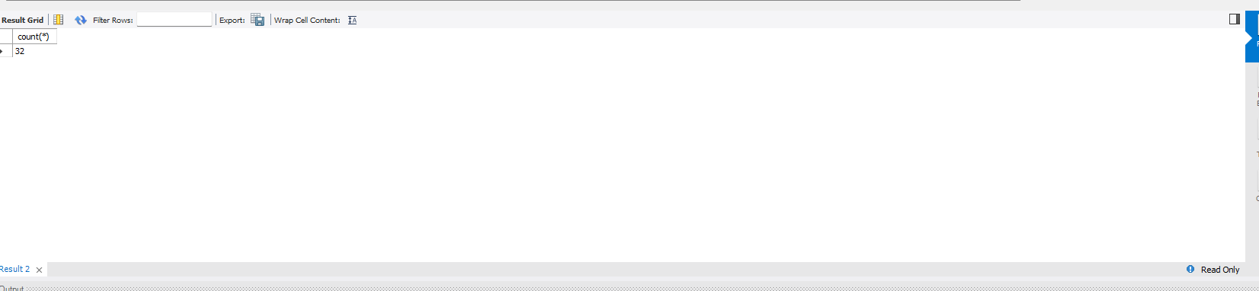
2. Total Number of Menu Items
SQL Query: SELECT COUNT(*) FROM menu_items;

Slide 5
3. Least and Most Expensive Menu Items
SQL Query: SELECT * FROM menu_items ORDER BY price DESC;
Most Expensive item= Shrimp scampi
Least Expensive item=Edemame

Slide 6
4. What are Italian Dishes Count
SQL Query: SELECT COUNT(*) FROM menu_items WHERE Category='Italian';
Answer: 9

Slide 7
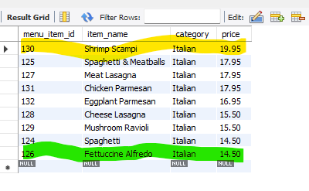
5. What are Least and Most Expensive Italian Dishes
SQL Query for least expensive: SELECT * FROM menu_items WHERE Category='Italian' ORDER BY price;
SQL Query for most expensive: SELECT * FROM menu_items WHERE Category='Italian' ORDER BY price DESC;
Answer: Least Expensive = Fettucine Alfredo Most Expensive= Shrimp Scampi

Slide 8
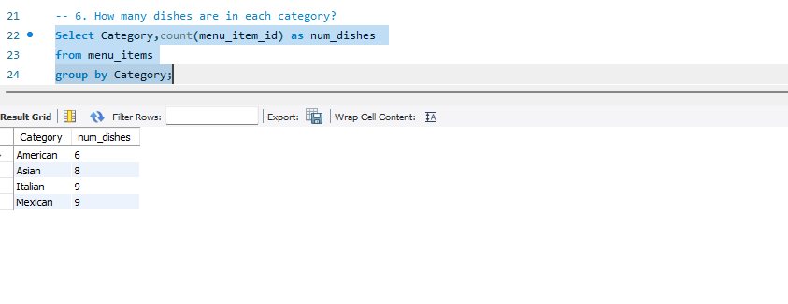
6. What are number of Dishes per Category
SQL Query: SELECT Category, COUNT(menu_item_id) AS num_dishes FROM menu_items GROUP BY Category;

Slide 9
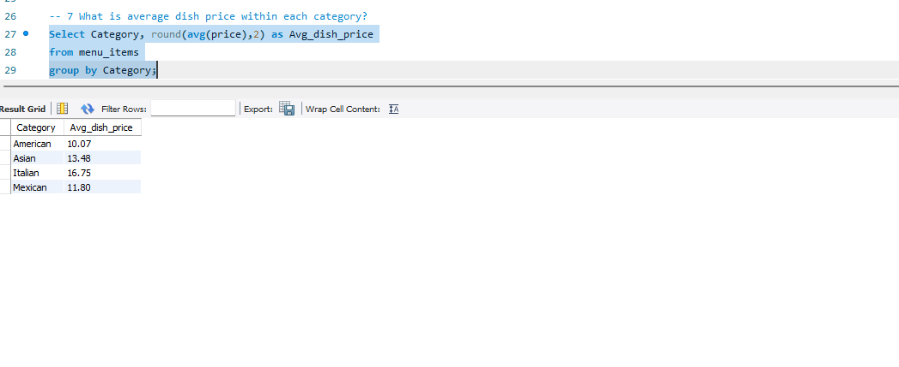
7. Average Dish Price per Category
SQL Query: SELECT Category, ROUND(AVG(price),2) AS Avg_dish_price FROM menu_items GROUP BY Category;

Slide 10
Order Details Analysis

Slide 11
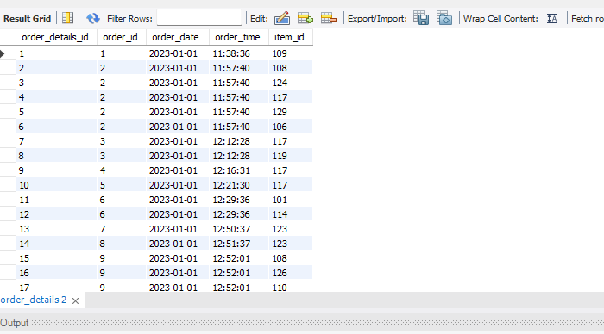
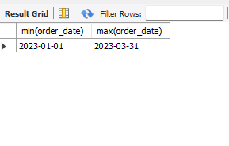
1. Viewing the Order Details Table & Date Range
SQL Query: SELECT * FROM order_details;
SQL Query: SELECT MIN(order_date), MAX(order_date) FROM order_details;

Slide 12
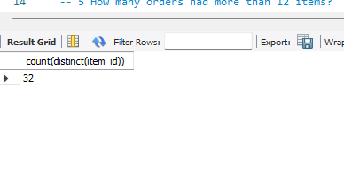
2.What is total orders count ?
SQL Query: SELECT COUNT(DISTINCT(item_id)) FROM order_details;

Slide 13
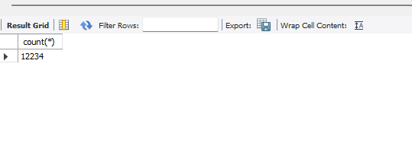
3 . What are total Items ordered
SQL Query: SELECT COUNT(*) FROM order_details;

Slide 14
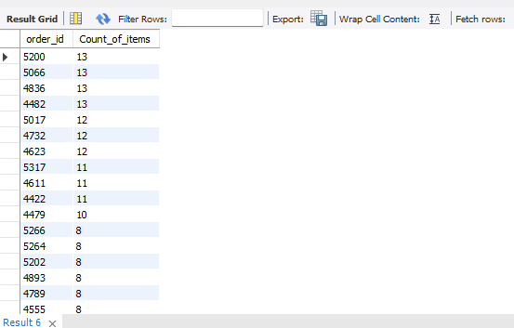






4. What is the order with most Items?
SQL Query: SELECT order_id, COUNT(item_id) AS Count_of_items FROM order_details GROUP BY order_id DESC;
Answer:
Orders with ID 5200, 5066,4836 and 4482 are the orders with most items

Slide 15
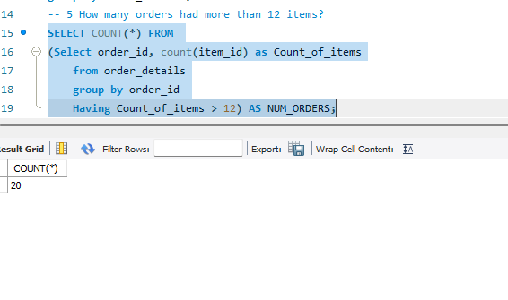

5. How many orders had more than 12 items? SQL Query: SELECT COUNT(*) FROM (SELECT order_id, COUNT(item_id) AS Count_of_items FROM order_details GROUP BY order_id HAVING Count_of_items > 12) AS NUM_ORDERS;
Answer:
There are 20 orders with more than 12 items

Slide 16
Customer Behavior Analysis

Slide 17
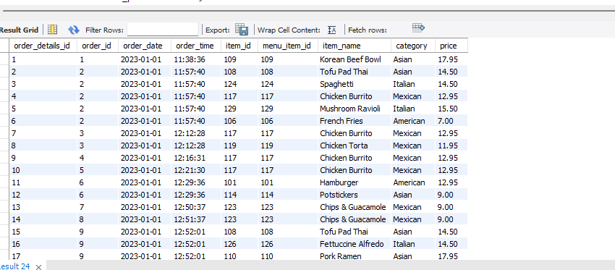
1. Combine the menu_items and order_details tables into a single table. SQL Query: SELECT * FROM order_details od LEFT JOIN menu_items mi ON od.item_id = mi.menu_item_id;

Slide 18
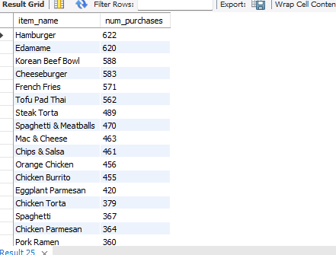
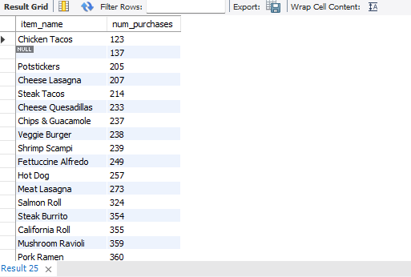


2. What were the least and most ordered items? What categories were they in? SQL Query: SELECT item_name, COUNT(order_details_id) AS num_purchases FROM order_details od LEFT JOIN menu_items mi ON od.item_id = mi.menu_item_id GROUP BY item_name ORDER BY num_purchases DESC;
Most ordered = Hamburger
Least ordered = Chicken Tacos

Slide 19
3.What are least and most ordered items by category?
SQL Query: SELECT item_name, Category, COUNT(order_details_id) AS num_purchases FROM order_details od LEFT JOIN menu_items mi ON od.item_id = mi.menu_item_id GROUP BY item_name, Category ORDER BY num_purchases DESC;
Answer:
Most ordered category=American
Least ordered category= Mexican

Slide 20
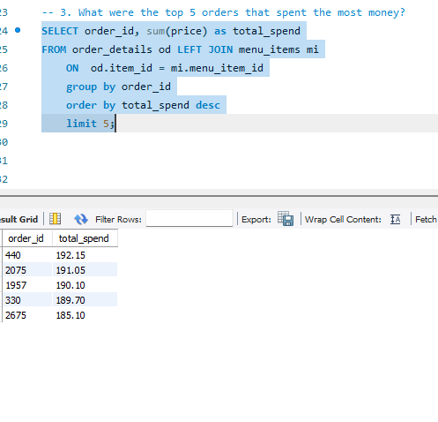
3. What were the top 5 orders that spent the most money? SQL Query: SELECT order_id, SUM(price) AS total_spend FROM order_details od LEFT JOIN menu_items mi ON od.item_id = mi.menu_item_id GROUP BY order_id ORDER BY total_spend DESC LIMIT 5;

Slide 21
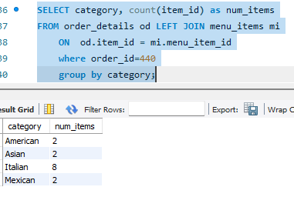



4. View the details of the highest spend order. Which specific items were purchased? SQL Query: SELECT category, COUNT(item_id) AS num_items FROM order_details od LEFT JOIN menu_items mi ON od.item_id = mi.menu_item_id WHERE order_id=440 GROUP BY category;

Slide 22
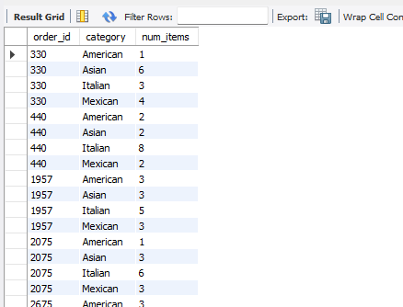
5. View the details of the top 5 highest spend orders SQL Query: SELECT order_id, category, COUNT(item_id) AS num_items FROM order_details od LEFT JOIN menu_items mi ON od.item_id = mi.menu_item_id WHERE order_id IN (330, 440, 1957, 2075, 2675) GROUP BY order_id, category;

Slide 23
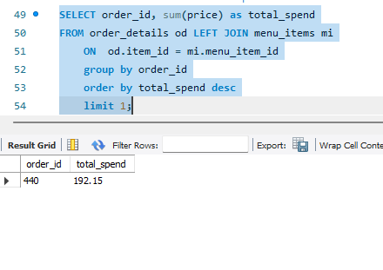

6. How much was the most expensive order in the dataset? SQL Query: SELECT order_id, SUM(price) AS total_spend FROM order_details od LEFT JOIN menu_items mi ON od.item_id = mi.menu_item_id GROUP BY order_id ORDER BY total_spend DESC LIMIT 1;
Answer:
The price of most expensive order is 192.15.

Slide 24
Key Business Applications of the Analysis
Menu Optimization: Identify bestsellers, remove underperforming dishes, and adjust pricing.
Revenue Growth: Target high-spend customers with promotions and upselling strategies.
Customer Insights: Understand demand trends, popular cuisines, and high-value orders.
Inventory Management: Forecast ingredient needs based on frequently ordered items.
Operational Efficiency: Improve order fulfillment and reduce waste by analyzing large orders.
Strategic Planning: Expand successful categories, introduce new dishes, and refine pricing models.
This analysis helps drive profitability, enhance customer experience, and streamline restaurant operations.

Slide 25
Thank you for your time!
Created by: Zohal Zahir

